Slide 1
PREDICTION OF BIKE RENTAL
BY:
02 – Vani Bandi
13 – Priti Kolkante
14 – Shravan Kota
18 – Vaishnavi Kulkarni
19 – Hasmina Bee Laskar
36 – Furqan Syed

Slide 2
ACKNOWLEDGEMENT
This project would not have been possible without the kind support and incredible help of many individuals. I would like to extend my sincere thanks to all of them.
I am indebted to Mrs. Jyoti Mantri for her guidance and constant supervision as well as for providing necessary information regarding the project and also for her support in completing the project.
I would like to express my gratitude towards Mr. Dinesh Chaurasiya Sir, Head of Department of Statistics, for providing us an opportunity to work on this project and clearing our doubts whenever required.
My thanks and appreciation also goes to all the teachers of department of statistics for the completion of this project wouldn't be possible without their great teachings.
Last but not the least, to all my fellow classmates who have always been there for answering my questions and giving simplified explanations, I express my gratitude. Thank you!

Slide 3
01 | AIM
02 | OBJECTIVE
03 | MODEL DESCRIPTION
04 | DATA DESCRIPTION
05 | DATA ANALYSIS
06 | RESULT
07 | CONCLUSION
08 | REFERENCE
TABLE
OF
CONTENTS

Slide 4
01. Aim To predict number of bike rentals in a day

Slide 5
02. OBJECTIVE The aim of this project is to forecast the number of bike rental per day by using regression analysis

Slide 6
03. Regression
Do you know we have learnt regression in the Schools?
Yes we learnt regression in the school the it is the extension of the Equation for a straight line.
Regression analysis is one of the Supervised learning technique studying the dependence of one variable called dependent variable or one or more variable called explanatory variable.
The regression analysis primarily used to:
Estimate the relationship that exist, on the average between the depend variable and the explanatory variable.
Depending the effect of each explanatory variables on the dependent variables controlling the effects of all others explanatory variables.
Predict the value of dependent variable for a given value of explanatory variable.
The simple univariate regression is given by Yi = β0 +β1xi + ϵi
Where β0 and β1 are the regression coefficient,
ϵ is the random error YI is the dependent variable and XI is explanatory variable.

Slide 7
Assumptions
Linearity: Data must me in linear relationship - Scatter plot
Normality: The error terms approaches normal – QQ Plot
Multicollinearity :independent variable depends on each other-VIF, Correlation between explanatory variables
Homoscedasticity: Constant variance-Residual vs Fitted
Autocorrelation: No correlation between the residuals- Durbin Watson Test

Slide 8
04. DATA DESCRIPTION

Slide 9


BIKE RENTAL SYSTEM
Through this system, user can easily rent a bike from a particular position and return at another position. Currently, there are about over 500 bike-sharing programs around the world which is composed of over 500 thousands bicycles.
Location 1
Location 2

Slide 10
Introduction to variables
SERIAL NO | VARIABLE | MEANING | SERIAL NO | VARIABLE | MEANING
1 | Instant | Serial number | 9 | weathersit | Weather situation
2 | Dteday | Date | 10 | Temp | temperature
3 | Season | Seasons | 11 | Atemp | Temperature feel
4 | Yr | Year | 12 | Hum | Humidity
5 | Mnth | Month | 13 | Windspeed | Windspeed
6 | Holiday | Holiday-1 Non Holiday -0 | 14 | Casual | Unregistered
7 | Weekday | Weekdays like Monday,Tues,etc | 15 | Registered | Registered
8 | Workingday | Neither Weekend nor holiday-1 | 16 | cnt | Consumer count

Slide 11
05. Code

Slide 12
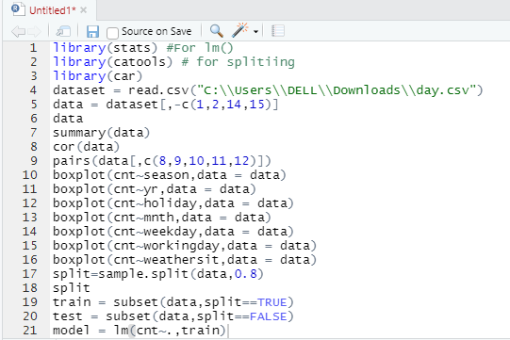
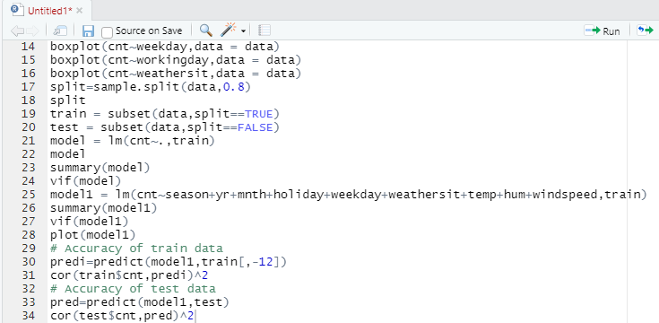

Slide 13
06. DATA ANALYSIS

Slide 14
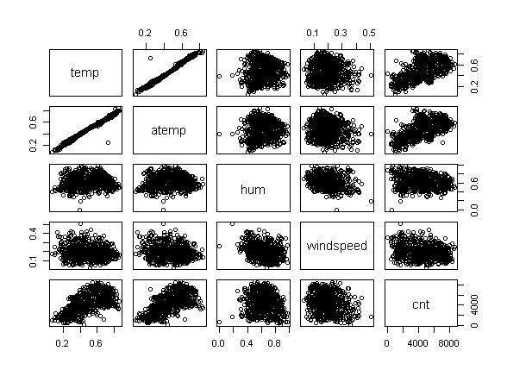
PAIR PLOT
Inference : From the above pair plot it can be clearly observed that there exists a linear relationship between temp, atemp & cnt

Slide 15
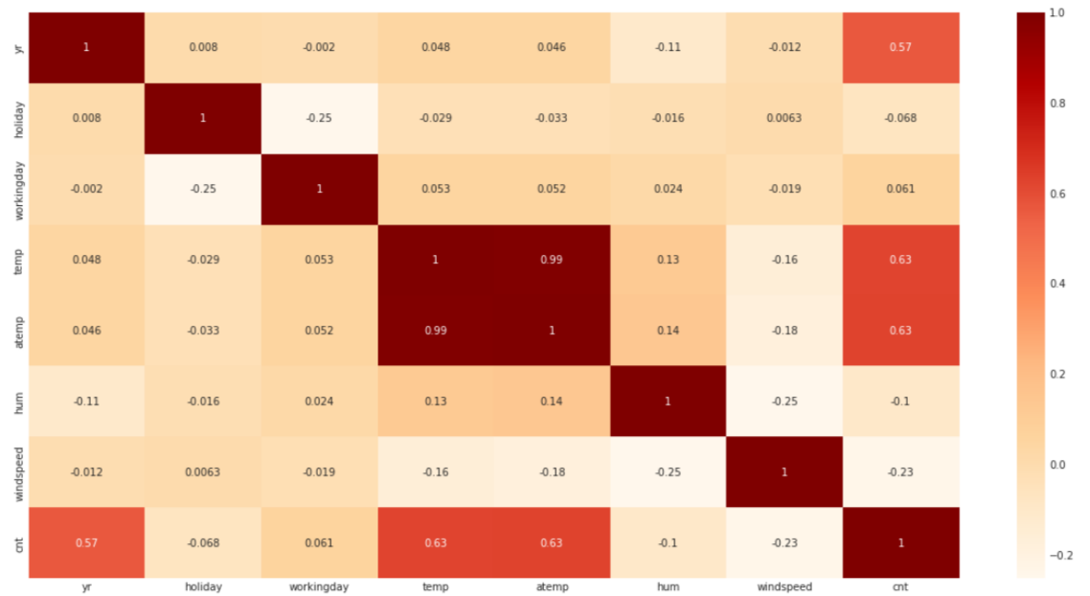
CORRELATION MATRIX
Inference :
As suspected, there is 99% correlation between temp and atemp.
We can hence drop one of these later while building our model.

Slide 16
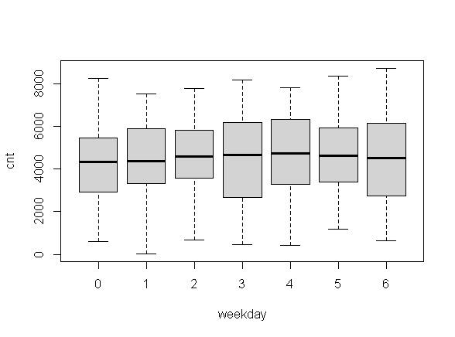
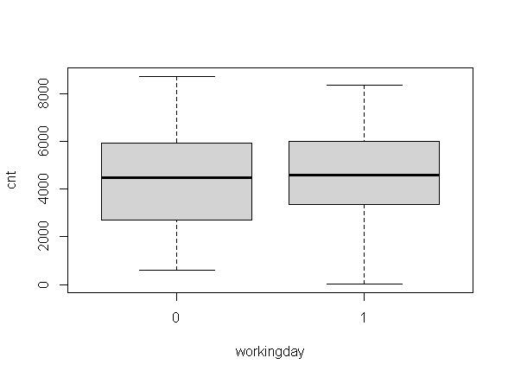
BOX PLOT
No clear pattern observed here as all the days show a similar spread. This may not be able to serve as a good predictor
We have a high booking count on working day and a median value close to 5000. It may serve as a good predictor

Slide 17
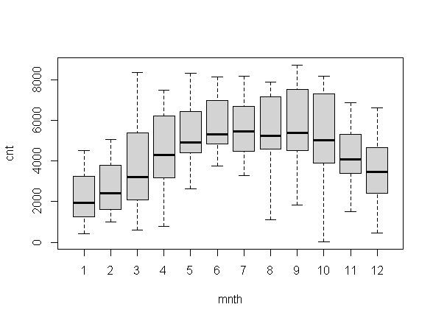
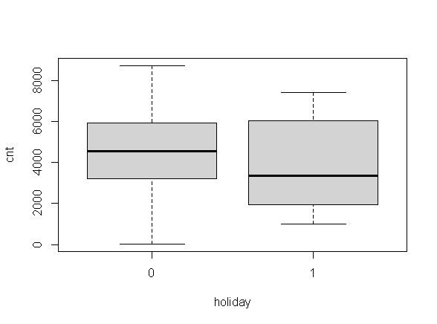
It looks like normally distributed,: 5-9 leading in number of bookings and crossing the median over around 4500-5000. This indeed can serve as a good predictor.
Majority(~ 97%) of the booking took place when it wasn't a holiday. We have a very high bias here and thus it may not be a good predictor variable.

Slide 18
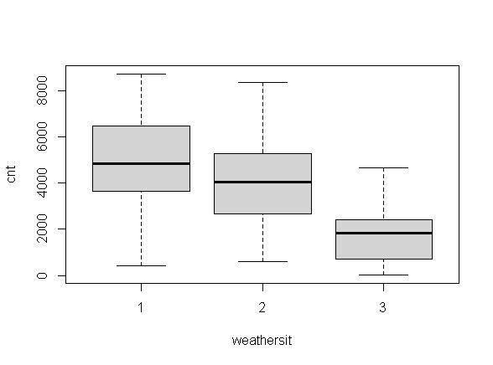
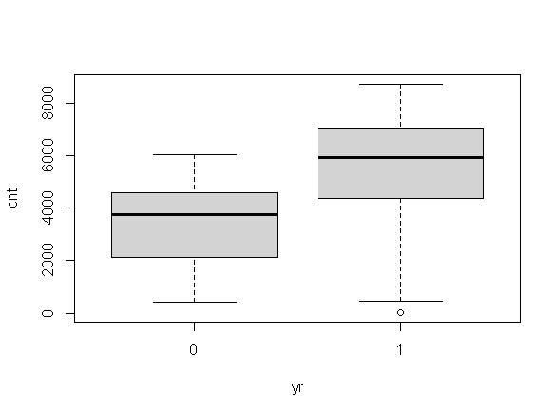
Majority of the bookings took place during a clear/partly cloudy weather with a median at around 5000 followed by misty/cloudy weather, with median 4000. This can also serve as a good predicton
During yr 1 , we have more number of bookings (almost twice) than yr 0. Since our analysis will be based only on two years (2018 and 2019), they are important predictors.

Slide 19
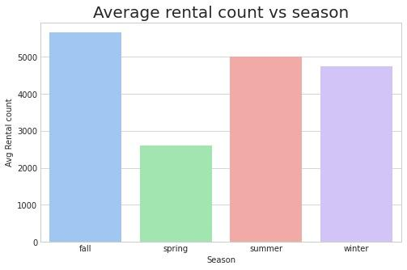
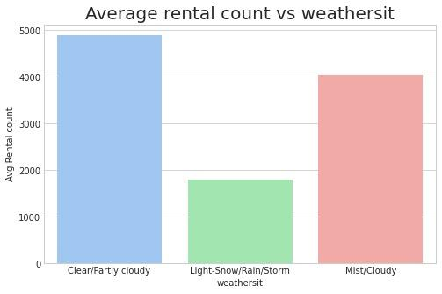
BAR PLOT
rental vs season : Highest rental counts during fall season and lowest during spring season
rental vs wheathersit : Highest rental counts during weather pattern clear/partly cloudy and lowest during light snow/rain/storm

Slide 20
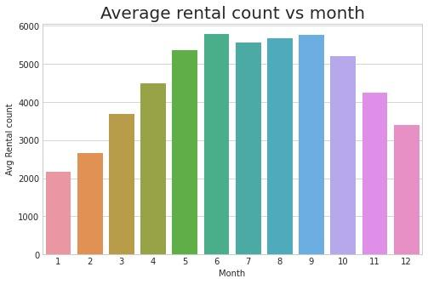
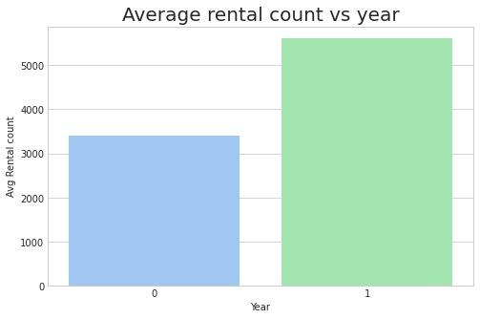
BAR PLOT
rental vs month : Highest rental counts during July-Sept (fall season) and lowest during Dec-Feb (extreme weather)
rental vs year : Rental counts are almost twice for year 1 as compared to year 0

Slide 21
07. RESULTS

Slide 22
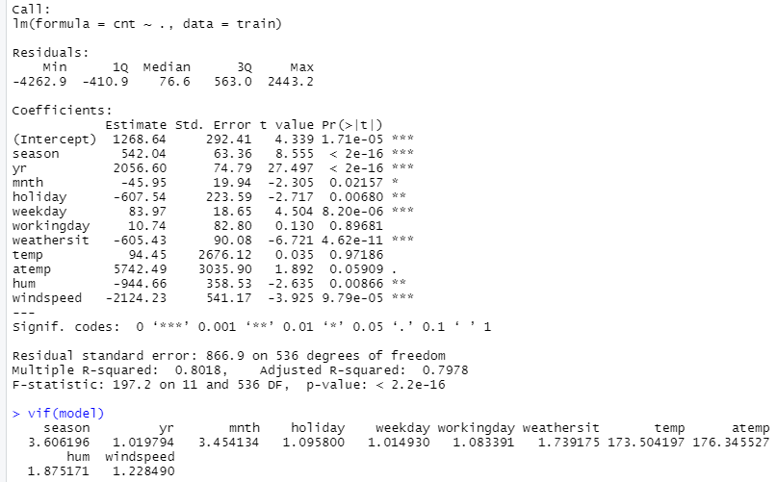
BOX PLOT
Initial Model
Temp and working variable is insignificant because its p value is greater than 0.05 and vif value of atemp is very large so we remove this variable from the model.

Slide 23
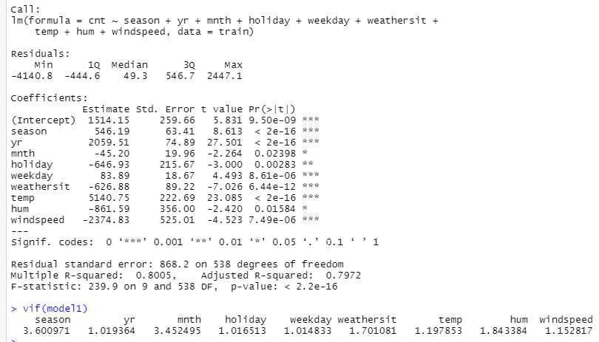
BOX PLOT
Final Model

Slide 24
01
02
We built a Multiple Linear Regression Model using bike rental dataset. (all variables except instant, datday, casual, registered,temp,workingday)
The minimum residual of the model is -4140.8 and maximum is 2447.1
03
04
Our fitted regression model is cnt=1514.15+546.19season+2059.51yr-45.20mnth-646.93holiday+83.89workingday-626.88weathersit+5150.75temp-861.59hum-2374.83windspeed
Each coefficient of independent variables tells us the average increase in the response variable when 1 unit increases in the predictor variable assuming all the other variables are held constant

Slide 25
05
06
Std. error measures the uncertainty in estimating the coefficient
p value >0.05 means variable has insignificant effect in model
07
08
F value indicates whether the regression model provides the better fit than a model that contains no independent variables p-value <0.05 then the model is better than the model with no predictor variable
Adj R-square =0.7972 is the proportion on variance the response variable that can be explained the predictor variable

Slide 26
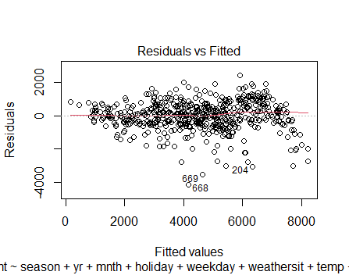
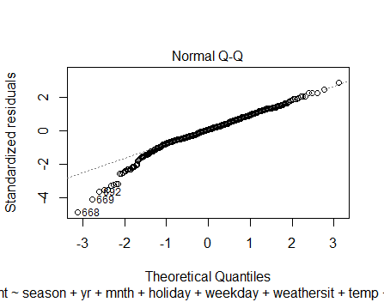
RESIDUAL v/s FITTED
There is no visible pattern data is scattered in this plot. Hence the relationship is linear and error variance is constant
NORMAL Q-Q
With a normal probability plot, it can be easier to see individual data items that don't quite fit a normal distribution. In the graph, The data is approximately normal.

Slide 27
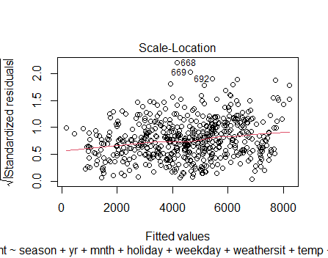
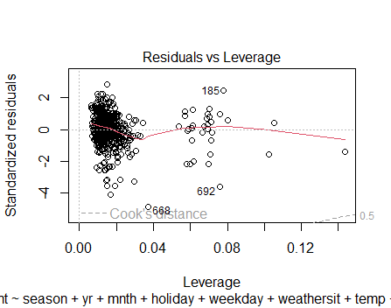
SCALE LOCATION
From the above graph, we can observe that he residuals are spread equally.
RESIDUALS v/s LEVERAGE
As seen in the graph, there are some outliers.

Slide 28
08. CONCLUSION

Slide 29
In this project we had fitted multiple linear regression model to predict the no of customers who rent the bike in a day.
Training Accuracy is 80%
Testing Accuracy is 79%.
There is low bias and low variance in our model.

Slide 30
09. REFERENCE

Slide 31


BOOKS
WEBSITES
•Statistical Methods and use of R software authored by P. G. Dixit
•Regression analysis by manish sane
•Statistical Computing by using R software by Vishwas Pawgi
Data Set;
Dataset Link
CODE:
Code Link

Slide 32
THANK YOU

